Slide 1

Intruder alert System
Group Name: Flamingo
Group Members:
Asmaul Husna Rima
ID: 182002003
MD Shahrior Shawon Prio
ID: 192002032
Jerin Joti Alamgir
ID: 182002063

Slide 2

CONTEXT
Introduction
Objective
System Design Approach
Interview Questionnaire
Functional/Non-Functional Requirements/Analysis
Diagrams
Prototype Designing
Feedback And Evaluation
Conclusion
Future Scope
References

Slide 3

INTRODUCTION
In our Information System Design lab, we must create a project based on our learning outcomes of the labs.
As supervised on the first lab we have to produce some unique idea of a project which we will develop through the semester.
We gathered several project ideas from each of the group members and did feasibility study for all the projects.
Project identification was based on facts like scopes, advantages, complexity, market analysis, ranking project then finally selecting the best project.
Finally, we came up with an idea which is “INTRUDER ALERT SYSTEM FOR HOME/RESIDENTS”.
Intruder alert system for home use is a design that detects the presence of an intruder in restricted areas and informs the user by triggering an alarm.
The system is based on hardware controller and other electronic design.
The idea is quite trendy and necessary for the upcoming revolution of enhancing security based on information technology.

Slide 4

OBJECTIVE
Our objective or goal is exactly like our project idea name.
Intruder alert system presents a smart trespasser detection and alert system for home which aims to increase the amount of security.
As well as the likelihood of positively identifying or stopping trespassers.
Using multiple sensors, this system can gauge the extent of danger exhibited by a person in or around the home parameters.
Can forward certain critical information regarding the same to homeowners as well as other specified persons such as relevant security authorities.
The aim and objective of this project is to provide a cost effective and efficient security services for home use, to offer its users a paramount security.

Slide 5
SYSTEM DESIGN APPROACH
We started the planning phase after completing identification of the project.
Then we started analysis of the project based on the facts we described.
To do a well-organized analysis there are some procedures.
The first procedure would be creating an interview questionnaire about the project.
Then the requirement analysis and complexity.
The interview guide and the answers are briefly discussed on the next slide.

Slide 6
INTERVIEW QUESTIONNAIRE
What different types of intruder alarms system does Flamingo Security install?
Will the Police Come when the Alarm Goes Off?
Does the system work at night?
Is it possible to have alarms which are not monitored, or customer solely controls?
Does this intruder alarm system easy to use?
Does our alarms sensitive to pets?
Will our alarm work in a power cut?

Slide 7

FUNCTIONAL REQUIRMENTS
Intruder emergency Response.
Detect intrusions specific to a designated area of protection.
Intruder detection and false alarm detection.
Entry Exit detection.
Perimeter Detection.
Automatically record events and incidents then suggest other users.
Perform data reduction, preferably at the source, to lessen data load.
Refine raw data to eliminate redundancy and false alarms.

Slide 8

NON-FUNCTIONAL REQUIRMENTS
The response time of the system would be immediate.
Video camera specification.
Utilization of the system would be nearly 100 percent
Capability to create reports for following up on and taking corrective action on
Suspicious events or discovered vulnerabilities not getting immediate attention
A site profile database, to be used by an operator to maintain a record of site- specific activity.

Slide 9
FUNCTIONAL REQUIRMENTS ANALYSIS
Multiple sensors will gather the sensing information of the intruder.
The ultrasonic passive infrared (PIR) sensors are to sense biological, visual, auditory disturbance or any kind of combination of this.
Image processing will help to detect body language, matching templates.
The Node MCU (IoT module) will help to automate the control to analyse.
The Process is:
Data analysis would be done by,
a) Local Binary Pattern.
b) Template Match.
c) Deep learning.
Face Detection
Face Extraction
Recognition

Slide 10
NON-FUNCTIONAL REQUIRMENTS ANALYSIS/COMPLEXITY
ANALYSIS
COMPLEXITY
Facial feature evaluation
Illumination using template
Face angle evaluation
Prediction confidence
Finding the proper intruder (Comparing faces, body heats with the perimeters ).
Complex algorithm.
Too many false alarms (If the sensors misbehave).

Slide 11

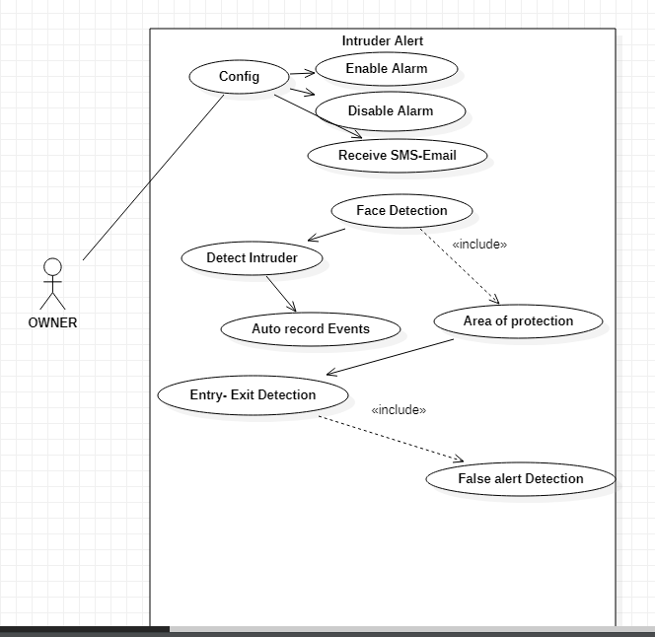
DIAGRAMS
13/05/2022
USE CASE DIAGRAM

Slide 12
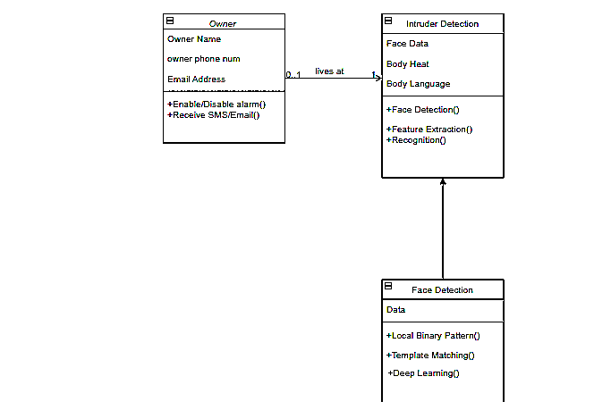
DIAGRAMS CONT.
13/05/2022
CLASS DIAGRAM

Slide 13
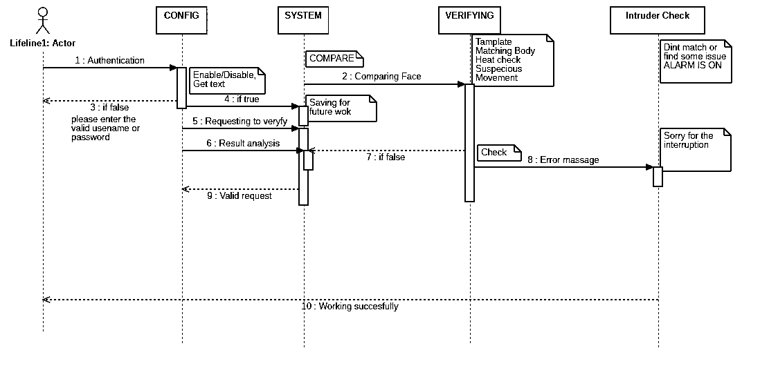
DIAGRAMS CONT.
13/05/2022
SEQUENCE DIAGRAM

Slide 14
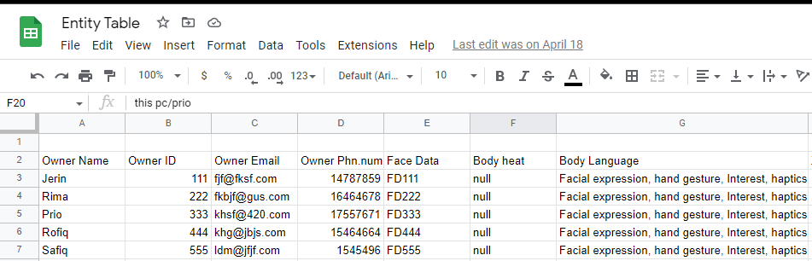
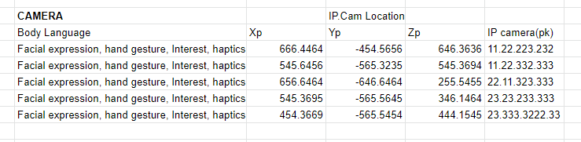
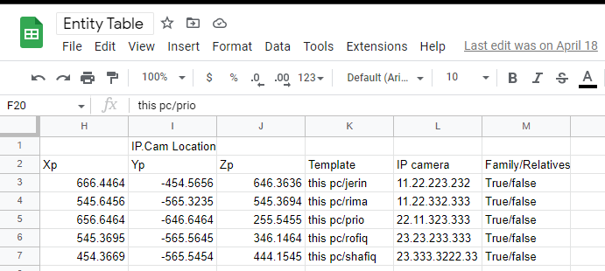
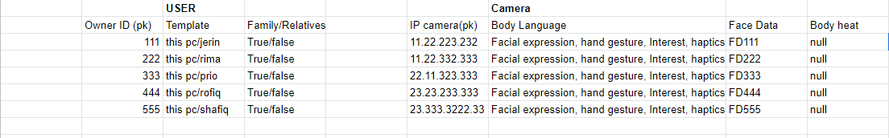
DIAGRAMS CONT.
13/05/2022
ER(TABLE) DIAGRAM

Slide 15

OUR GOALS OF PROTOTYPING
Prototyping enables evaluation, happens throughout.
Exploring requirements.
Market analysis, participatory design.
Choosing among alternatives.
Risky or critical features, go/no-go decisions.
As early as possible, try out ideas with target users.
Evaluate our development.

Slide 16
OUR JOURNEY TO THE PROTOTYPING PROCESS
13/05/2022
GOALS
FUNCTIONALITY
DEVELOP
EVALUATE

Slide 17
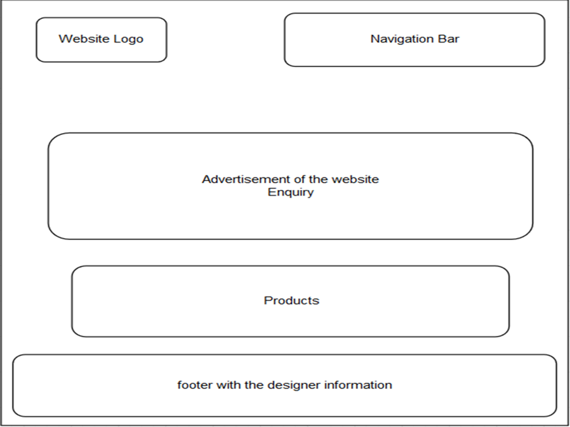
A ROUGH SKETCH
13/05/2022

Slide 18

TOOLS AND TECHNIQUES
13/05/2022
We used the online UI/UX designing tool figma.com to create our prototype.
It is easy and available for free use.

Slide 19
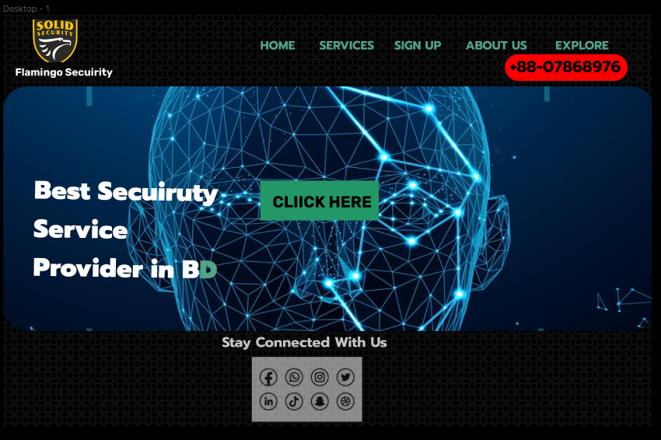
THE DEMO OF THE PROTOTYPE
13/05/2022
HOMEPAGE
8

Slide 20
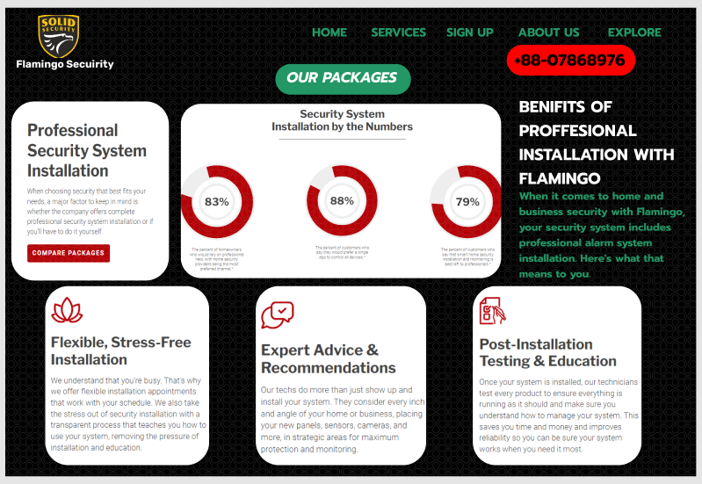
THE DEMO OF THE PROTOTYPE cont.
13/05/2022
SERVICES
9

Slide 21
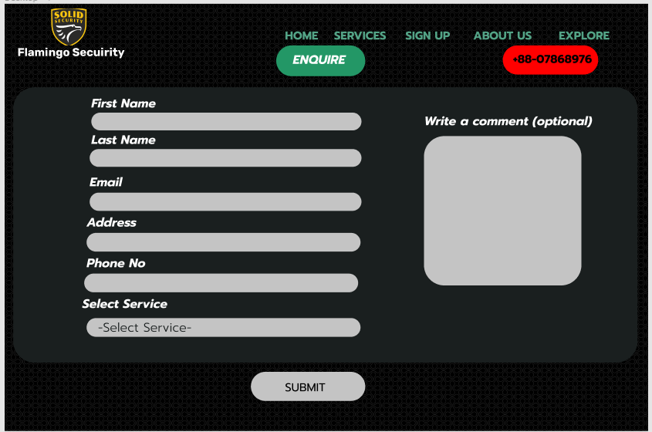
THE DEMO OF THE PROTOTYPE cont.
13/05/2022
SIGN-UP/ENQUIRY
10

Slide 22

THE DEMO OF THE PROTOTYPE cont.
13/05/2022
ABOUT US
11

Slide 23
FEEDBACK AND EVALUATION
13/05/2022
FEEDBACK
When we presented our demo on the online platform Figma, the prototype got well response from the audience.
The evaluation criteria were fulfilled.
We got one suggestion from the audience and which we really appreciate in order to make our services more perfect.
From the audience, one of them suggested, if any camera is not working or got any technical issue, the system will notify the authority and the support team immediately.
This is an important suggestion, and we will implement it ASAP.
12

Slide 24
CONCLUSION
13/05/2022
Intruder Security is a billion-dollar Industry, and a growing worldwide market.
The mobile and IP communications have developed and completely changed the way we now use, monitor and control intruder security systems.
The outcome of this project has developed our design and analysis skills.
This project offers an excellent knowledge about planning, design, and implementation stages.
As well as, gaining some experience on using engineering software tools for creating the diagrams and prototype.
12

Slide 25
FUTURE SCOPE & REFERENCES
FUTURE SCOPE
REFERENCES
This project has proposed an intruder alert system based on various factors.
The novelty of the system is the inclusion of intruder detection capability by analysing body heat, body language and alarm as method to warn the house owner.
Future research will explore other feature extraction and classification method to improve the accuracy of intruder detection.
https://www.intechopen.com/chapters/8720
https://studytronics.weebly.com/uploads/4/4/3/7/44372217/home_security_alarm_system_using_arduino_project_report.pdf
https://thescipub.com/pdf/jcssp.2019.1108.1122.pdf
https://cupdf.com/document/project-report-intruder-alert-system-2-1-abstrac
https://kipdf.com/intruder-alarm-system_5ac644541723ddb4d99168e1.html

Slide 26




Thank you
ANY QUESTIONS?

